Slide 1
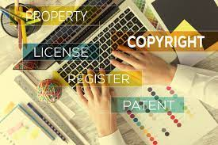

Chapter 4
Intellectual Property

Slide 2
Chapter Overview
Introduction
Intellectual property rights
Protecting intellectual property
Fair use
Peer-to-peer networks
Protections for software
Open-source software
Legitimacy of intellectual property جprotection for software

Slide 3
Introduction
Digital music storage + Internet → crisis
Value of intellectual properties much greater than value of media
Creating first copy is costly
Duplicates cost almost nothing
Illegal copying pervasive منتشر
Internet allows copies to spread quickly and widely
In light of information technology, how should we treat intellectual property?

Slide 4
What Is Intellectual Property?
Intellectual property: any unique product of the human intellect that has commercial value
Books, songs, movies
Paintings, drawings اللوحات والرسومات
Inventions, chemical formulas, computer programs اختراعات
Intellectual property (idea) الملكية الفكرية
physical manifestation (paper) مظاهر فيزيائية (ورق)

Slide 5
Property Rights
The Second Treatise of Government تعليمات
People have a right…
to property in their own person
to their own labor
to things which they remove from Nature through their labor (ex: cutting wood-logs-, gaining a land)

Slide 6
Analogy Is Imperfect المقاييس غيرعادلة
If two people write same play, both cannot own it ⎯ every intellectual property is one-of-a-kind
If one person “takes” another’s play, both have it copying an intellectual property is different from stealing a physical object

Slide 7
Benefits of Intellectual Property Protection
Some people are altruistic; some are not
People can benefit from having ownership of their ideas, and thus can improve the quality of life for others
Attraction of wealth can be an incentive for work. يمكن أن تكون جاذبية الثروة حافزًا للعمل.
Giving creators rights to their inventions encourages creativity حقوق الملكية حافزا للابداع

Slide 8
Limits to Intellectual Property Protection
Society benefits most when inventions in public domain
Congress has struck compromise حل وسط by giving authors and inventors rights for a limited time.
Authors of U.S. Constitution الدستور recognized benefits to limited intellectual property protection. (Ex: exclusive rights for novels for a limited period of time) الحقوق الحصرية للروايات

Slide 9
Protecting Intellectual Property
Trade secrets اسرار تجارية
Trademarks
Patents
Copyrights

Slide 10
1- Trade Secret
Confidential piece of intellectual property that gives company a competitive advantageسرية
Employees are asked to make confidentiality agreement
Examples:
Formulasمكونات , customers’ lists, strategic plans, branded design.
Not suitable for all intellectual properties (movies- they should be viewed and not to be kept in secret??)
Reverse engineering allowed (buying a can of Coca-Cola and trying to figure out it’s formula is legal)
May be compromised when employees leave firm
التعرض للخطر

Slide 11
2- Trademark, Service Mark
Trademark: Identifies goods
given by a government to a distinctive product
By word, symbol, picture, color, smell, sound
Service mark: Identifies services
Company can establish a “brand name”( apple, Nike, H&M, Adidas, Zara).
Does not expire
If brand name becomes common noun, trademark may be lost (Aspirin) ( fine) ( Tide)
Companies advertise to protect their trademarks, using adjectives not verbs or nouns.
Companies also protect trademarks by contacting those who misuse them (Photoshop must not be used as verb or noun from misusers)

Slide 12

3- Patent براءة اختراع
A public (not secret) document that provides detailed description of inventionاختراع
Provides owner with exclusive right to the invention
Owner can prevent others from making, using, or selling invention for 20 years.
After that anyone can make use of the idea
Example: Polaroid vs Kodak- instant photography شركة كوداك مقابل شركة بولاريد _البديل التصوير الفوري

Slide 13
4- Copyright
Provides owner of an original work five rights
Reproduction
Distribution (copies of the work to public)
Public display (copies of the work in public place )
Public performance. (quality)
Production of derivative works.( other copies)
Examples: movie, music, SW, book industry.
Copyright protection has expanded greatly since 1970.

Slide 14
Fair Use Concept
Sometimes legal to reproduce a copyrighted work without permission
Citing short excerpts for teaching, research, criticism, commentary, news reporting .
اقتباس مقتطفات قصيرة للتدريس والبحث والنقد والتعليق والتقرير الإخباري
Courts consider four factors or the four factors to consider in determining whether a particular use is a “fair use”:
1- Purpose and character of use
(Educational is permissible not commercial)
2- Nature of work
Fiction vs nonfiction (facts) and published preferred over non-published خيال وواقعي
3- Amount of work being copied
Brief excerpts not the entire work مختصرة
4- Effect on market for work
The use of out of print is permissible

Slide 15
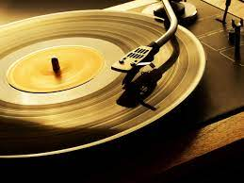
Digital Recording Technology
Copying from vinyl records to cassette tapes introduced distortions (bad quality)
Introduction of compact disc (CD) a benefit for music industry
Cheaper to produce than vinyl records
Higher quality
Higher price (companies charge more)⇒ higher profits
BUT it’s possible to make a perfect copy of a CD

Slide 16
Digital Rights Management
Actions owners of digital intellectual property take to protect their rights
Approaches
Encrypt digital content
Digital marking so devices can recognize content as copy-protected منع النسخ

Slide 17
Criticisms of Digital Rights Management
انتقادات لإدارة الحقوق الرقمية
Any technological “fix” is bound to fail
DRM reduce fair use
DRM could reduce competition
Some schemes مخطط make unknown access impossible
Media Player tracks the contents the users view
تتبع تشغيل الوسائط

Slide 18
Peer-to-Peer Networks
Peer-to-peer network
Transient network شبكة عابرة
Connects computers running same networking program
Computers can access files stored on each other’s hard drives
How P2P networks facilitate data exchange ?
Give each user access to data stored in many other computers
Support synchronized file transfers among random pairs of computers
Allow users to identify systems with faster file exchange speeds
Ex: (PCs that have faster transfer rate because they have ADSL speed)

Slide 19
Napster
Peer-to-peer music exchange network
Began operation in 1999
Sued by RIAA (Recording Industry Association of America ) for copyright violations.
رفع دعوى قضائية من قبل جمعية صناعة التسجيلات الأمريكية) لانتهاكات حقوق النشر)
Courts ruled in favor of RIAA
Went off-line in July 2001
Re-emerged in 2003 as a subscription music service
عادت للظهور في عام

Slide 20
BitTorrent تدفق وانسياب المعلومات
Broadband connections: download much faster than upload
BitTorrent speeds downloading
Files broken into pieces
Different pieces downloaded from different computers.
Used for downloading large files
Computer programs
Television shows
Movies
a peer-to-peer file transfer protocol for sharing large amounts of data over the internet, in which each part of a file downloaded by a user is transferred to other users.

Slide 21
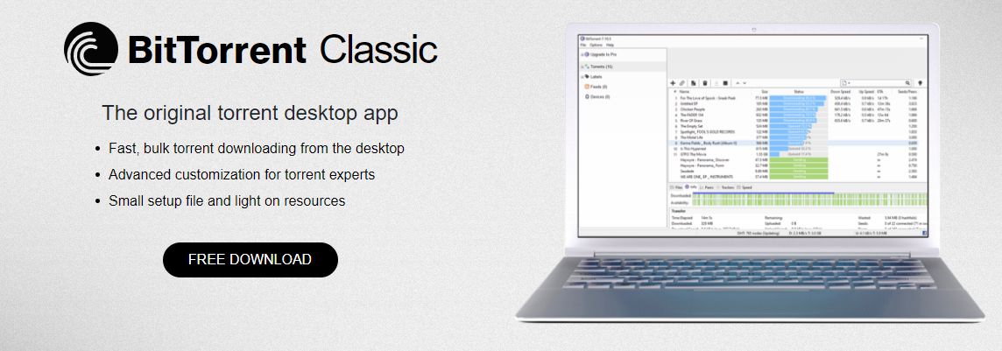

Slide 22
Universities Caught in Middle
Universities hotbed for file sharing
High-speed Internet access
High-capacity file servers
In 2003 RIAA(Recording Industry Association of America ) sued four students (for distributing copyrighted music) for about $100 billion (settled for $50,000).
في عام 2003 ، رفعت RIAA دعوى قضائية ضد أربعة طلاب (لتوزيعها موسيقى محمية بحقوق الطبع والنشر) مقابل حوالي 100 مليار دولار (استقرت بمبلغ 50000 دولار).
Different university responses
Taking PCs of students
Banning file-sharing حظر مشاركة الملفات
Signing agreements with legal file-sharing services like Napster (for fees)

Slide 23
Legal Music Services on the Internet خدمات الموسيقى القانونية على الإنترنت
Subscription services for legal downloading (like Napster)
Some based on monthly fee; some free
Consumers pay for each download
Apple’s iTunes Music Store leading service.

Slide 24
Protections for Software – Software Copyrights
Copyright protection began 1964
What gets copyrighted?
Expression of idea, not idea itself
Implementation of DBMS NOT the concept of it (App. Not Idea of DB)
Object program (.exe), not source program
Because source codes are secrets.
Companies deliver .exe النسخ التنفيذية فقط
Companies treatتتعامل source code as a trade secret

Slide 25
Violations of Software Copyrights انتهاكات حقوق النشر الخاصة بالبرنامج
Copying a program to give or sell to someone else
Preloading a program onto the hard disk of a computer being sold
Distributing a program over the Internet

Slide 26
Safe Software Development
Reverse engineering
Companies must protect against unconscious copying
Making the same duplicate of a program because programmers move from one firm to another
Solution: “clean room” software development strategy
Team 1 analyzes competitors’ programs and writes specifications.
Team 2 uses specifications to develop software

Slide 27
Open-Source Software

Slide 28
Open-Source Software: Consequences of Proprietary Software
Increasingly tough measures being taken to enforce copyrights (infringe our liberties تنتهك حرياتنا )
This act was created in an era with difficulties to make copies. This is not the case NOW.
Copyrights are not serving promoting progress. القيود لا تخدم التقدم
They make authors wealthy
It is wrong to allow someone to “own” a piece of intellectual property
Cooperation is more important than copyright,

Slide 29
Open Source Definition
Licenses have the following characteristics:
No restrictions preventing others from selling or giving away software
Source code included in distribution
No restrictions preventing others from modifying source code
No restrictions regarding how people can use software. They can exchange or sell.
Same rights apply to everyone receiving redistributions of the software)
NOTE: Nothing states that Open Source SW must be given FREE.

Slide 30
Beneficial Consequences of Open-Source Software
Gives everyone opportunity to improve program
New versions of programs appear more frequently
Eliminates tension between obeying law and helping others
Programs belong to entire community
Shifts focus from manufacturing to service
Buying Open Source SW with easy installation steps
Providing great manuals
Providing support after sales

Slide 31
Examples of Open-Source Software
BIND – give DNS for entire Internet
) BIND (Berkeley Internet Name Domain) is a software collection of tools including the world's most widely used DNS (Domain Name System) server software. This feature-full implementation of DNS service and tools aims to be 100% standards-compliant and is; intended to serve as a reference architecture for DNS software.Jan 14, 2020
Apache – runs half of Web servers
Send mail – moving e-mail via internet
GNU (General Public License) compilers for C, C++, Objective-C, Fortran, Java, and Ada

Slide 32
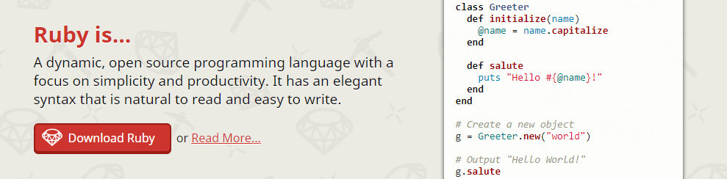
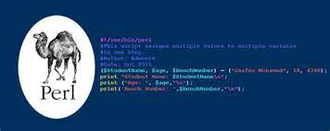
Perl, Python, Ruby, TCL/TK, PHP, Zope (is a free and open source web application server written in the object-oriented programming language Python. Since its release in 1998, )

Slide 33
Impact of Open-Source Software
Linux putting pressure on companies selling proprietary versions of Unix
Linux putting pressure on Microsoft and Apple desktops
Cost for these OSs goes down

Slide 34
Critique of the Open-Source Software Movement
Without attracting critical mass of developers, open source SW quality can be poor
Without an “owner,” incompatible versions may arise
Independent groups of users make enhancements, so many versions will appear – no compatibility
Relatively weak graphical user interface
Poor mechanism for stimulating innovation
No companies will spend billions on new programs

Slide 35
Legitimacy of Intellectual Property Protection for Software شرعية حماية الملكية الفكرية للبرامج
Software licenses typically prevent you from making copies of software to sell or give away.
Software licenses are legal agreements
Here we are not discussing morality of breaking the law.
We are discussing whether society should give intellectual property protection to software
utilitarian analysis.

Slide 36
Utilitarian Analysis تحليل الفوائد
Argument against copying
Copying software reduces software purchases…
Leading to less income for software makers…
Leading to lower production of new software…
Leading to fewer benefits to society
Each of these claims can be debated
Not all who get free copies can afford to buy software
Open-source movement demonstrates many people are willing to give their software-writing skills
Hardware industry wants to stimulate software industry
Difficult to quantify how much society would be harmed if certain software packages not released
It is not a matter of how many SW, but what they can be use for

